Slide 1
Midterm Case studies INFO7390 Advances in Data Sciences and Architecture
Group 9
Neha Gilson
Aastha Grover
Shuxian Wu

Slide 2
Case 1: West Roxbury
The goal of this case is to make a prediction for the total value of a home. The original dataset comes with following variables:
TAX | Tax bill amount based on total assessed value multiplied by the tax rate
LOT SQFT | Total lot size of parcel in square feet
YR BUILT | Year property was built
GROSS AREA | Gross floor area
LIVING AREA | Total living area for residential properties (ft2)
FLOORS | Number of floors
ROOMS | Total number of rooms
BEDROOMS | Total number of bedrooms
FULL BATH | Total number of full baths
HALF BATH | Total number of half baths
KITCHEN | Total number of kitchens
FIREPLACE | Total number of fireplaces
REMODEL | When house was remodeled (Recent/Old/None)
Input Variables:
Output Variable:
TOTAL VALUE | Total assessed value for property, in thousands of USD

Slide 3
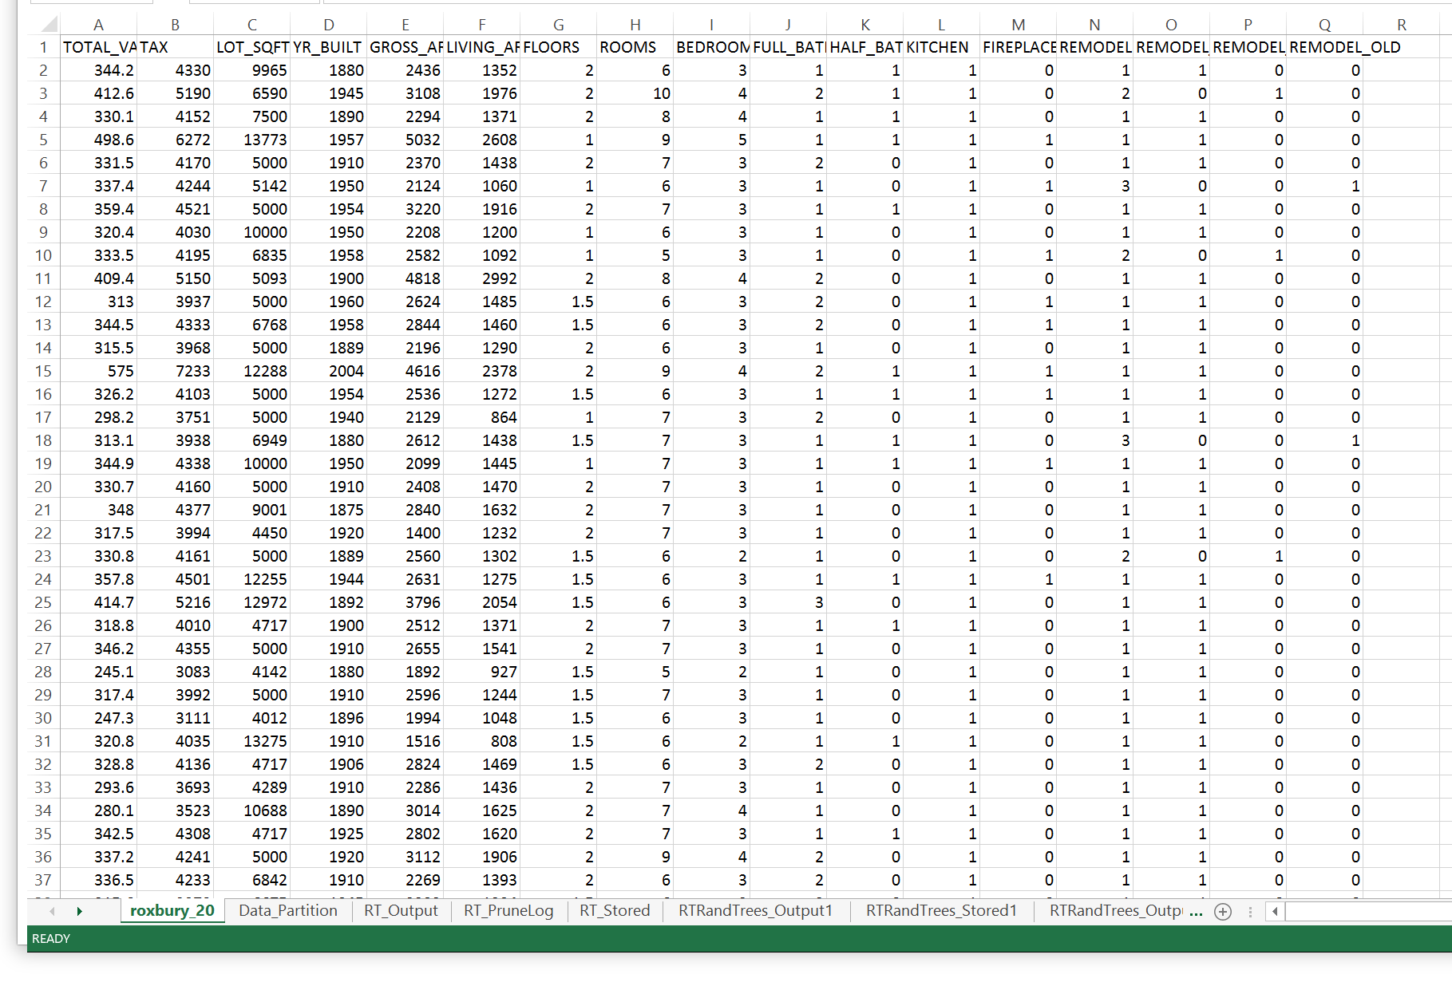
Data after cleansing

Slide 4
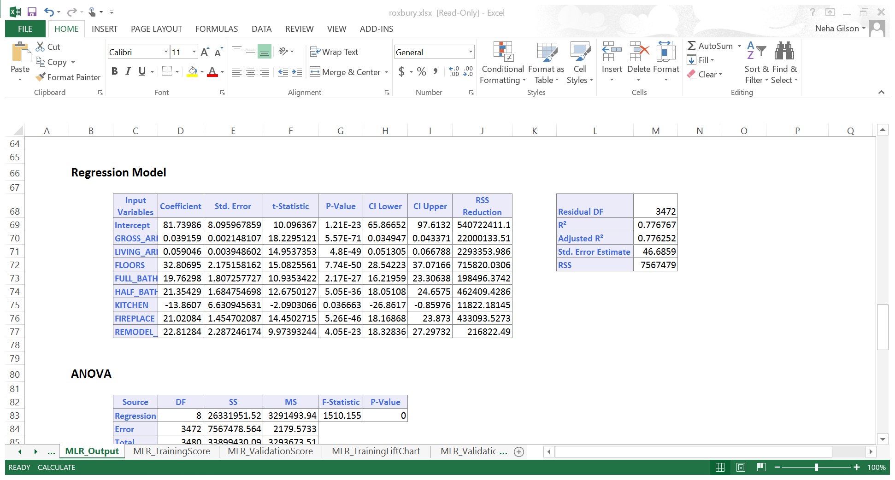
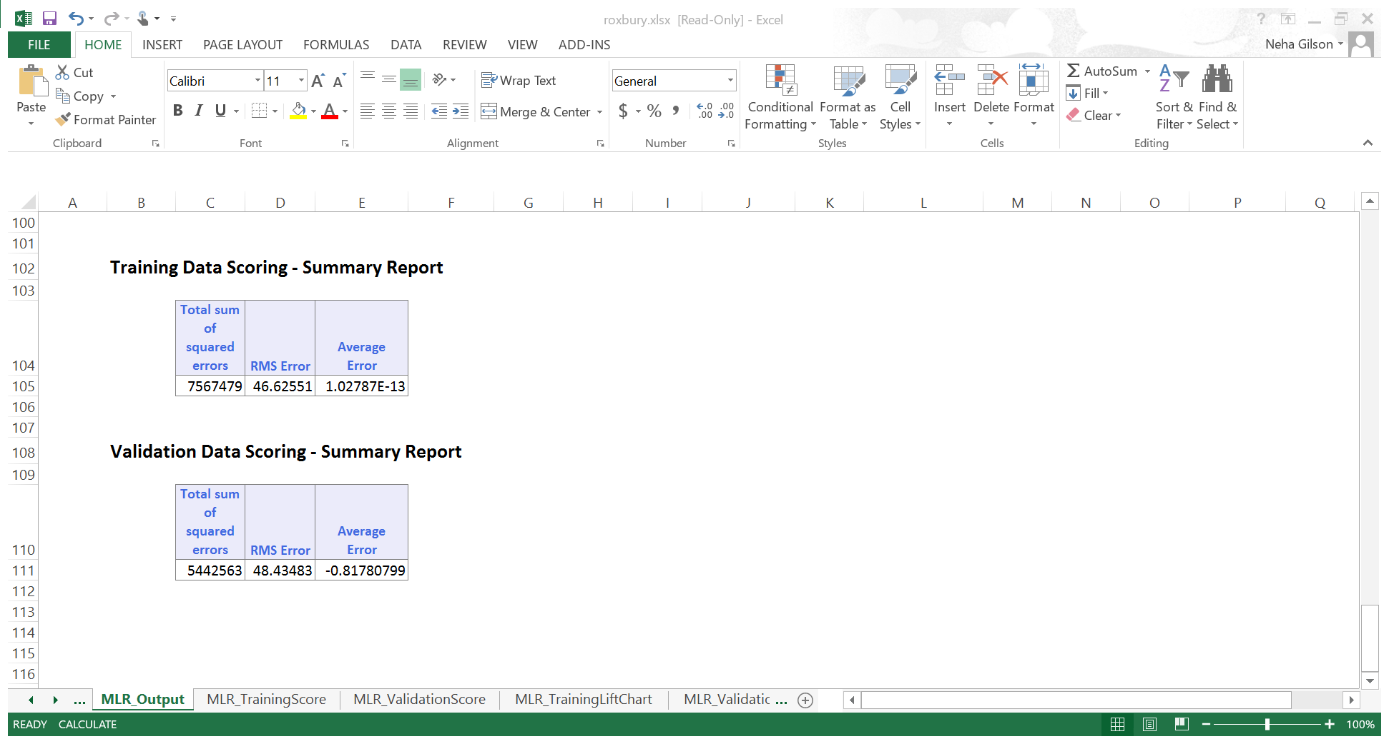
Prediction Models

Slide 5
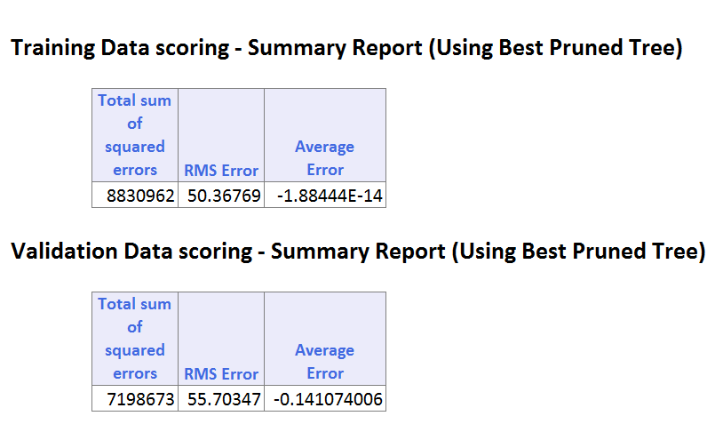
CART

Slide 6
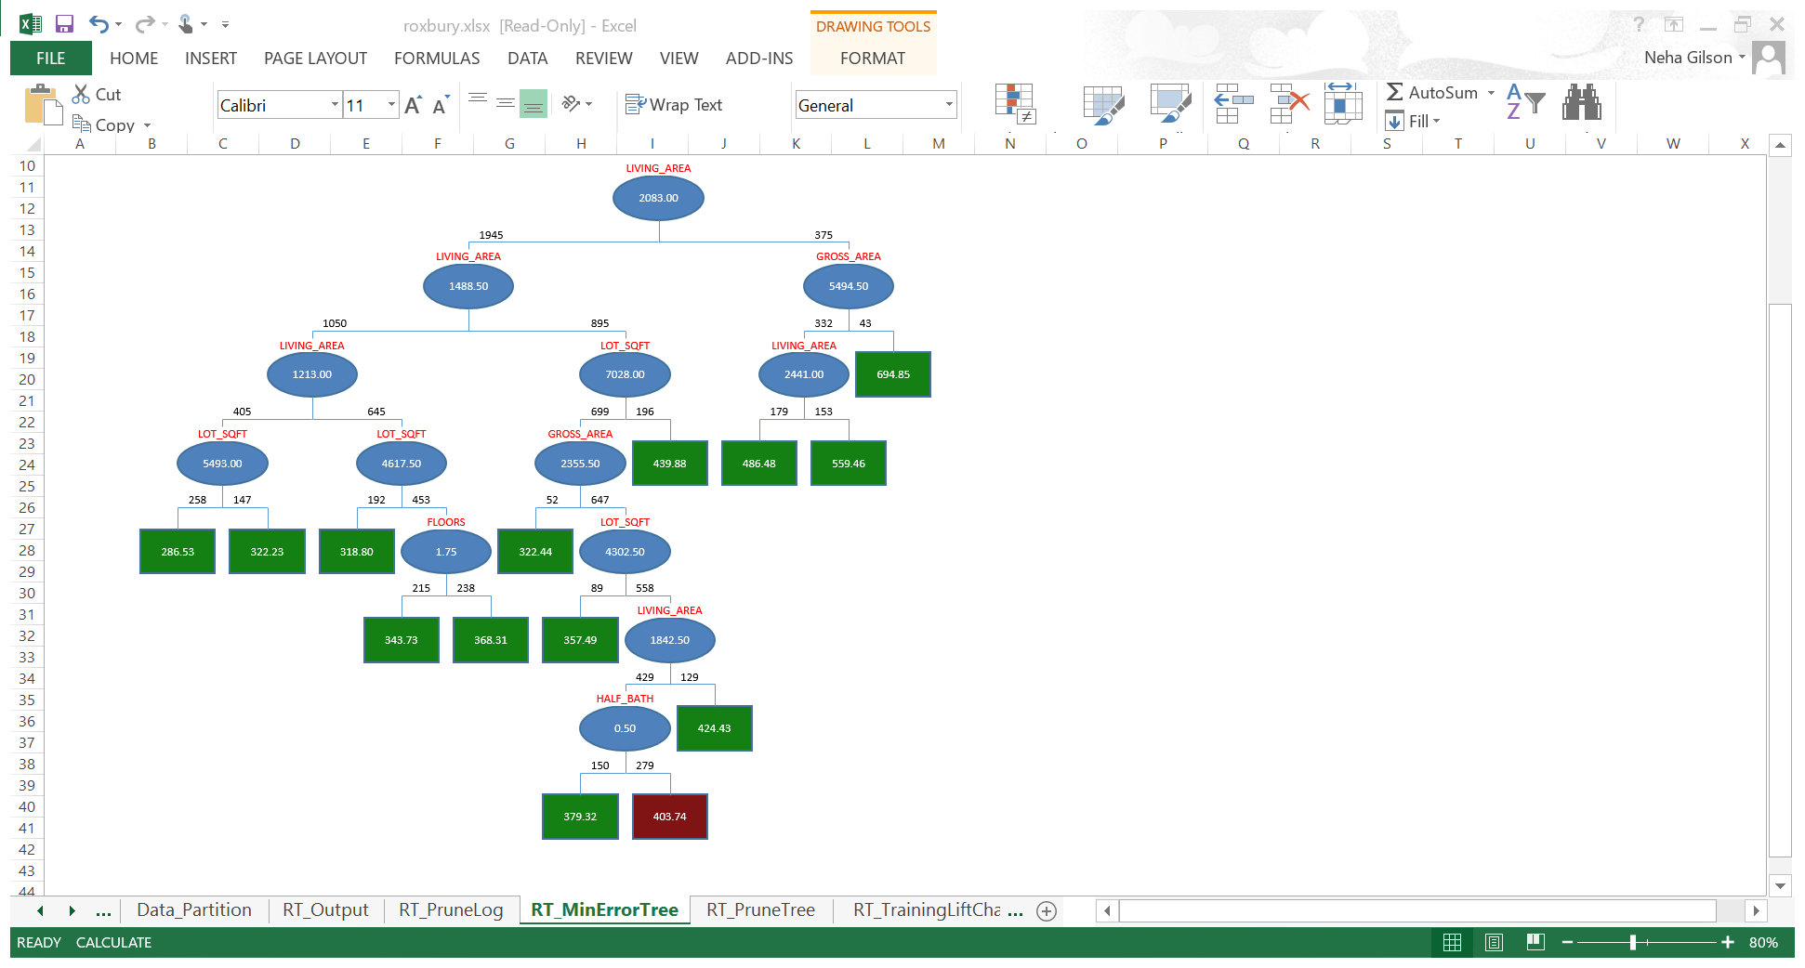
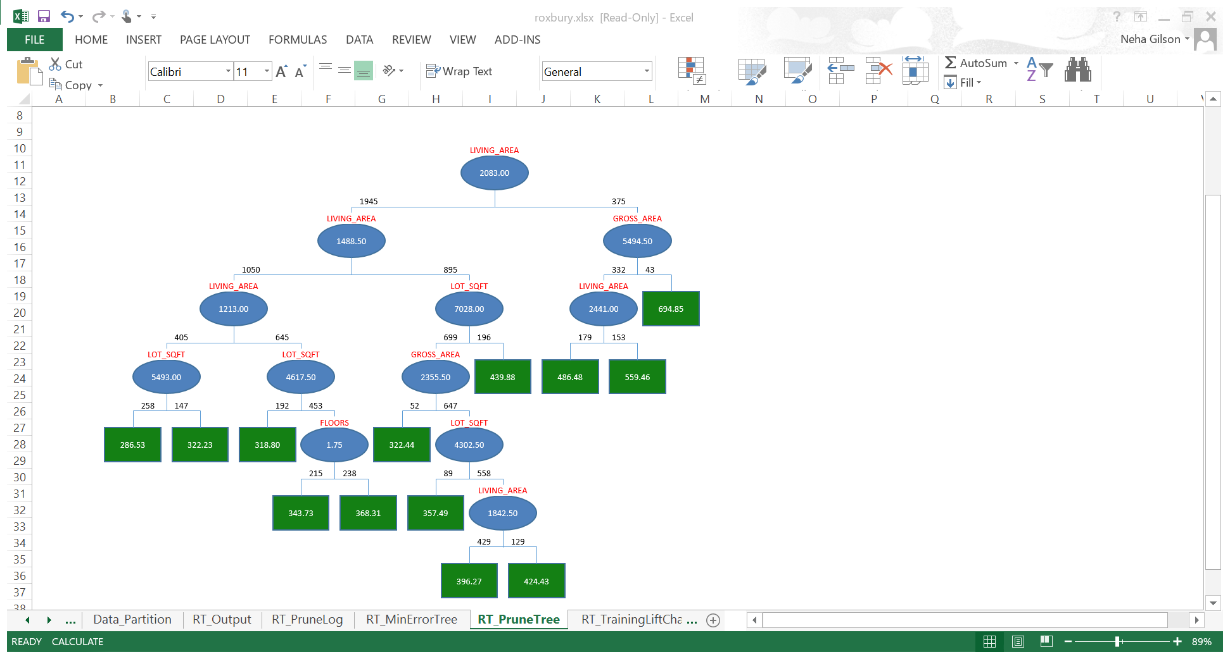
Min Error Vs Best Pruned

Slide 7
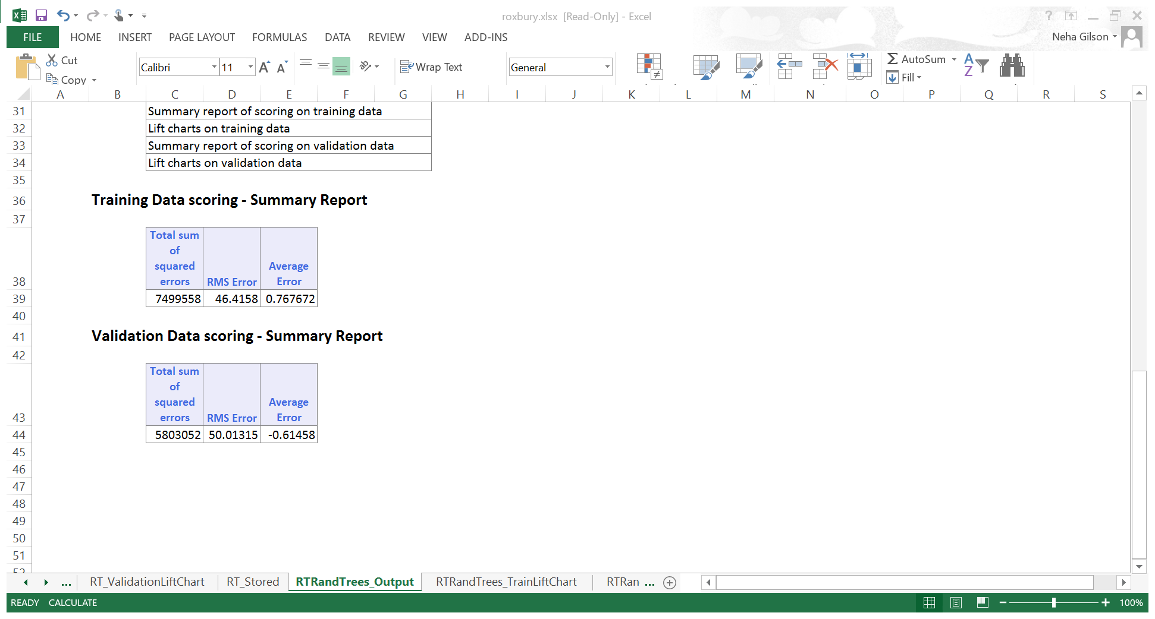
Random Forest

Slide 8
Conclusions
We compared the RMS errors and AUC in all the 3 above models and clearly, the best model is Multiple Linear Regression. RMSE has a significantly higher correlation to the distance from the ground truth on average than AUC.
We would recommend that for future prediction of home values the MLR model gives a more accurate result.

Slide 9
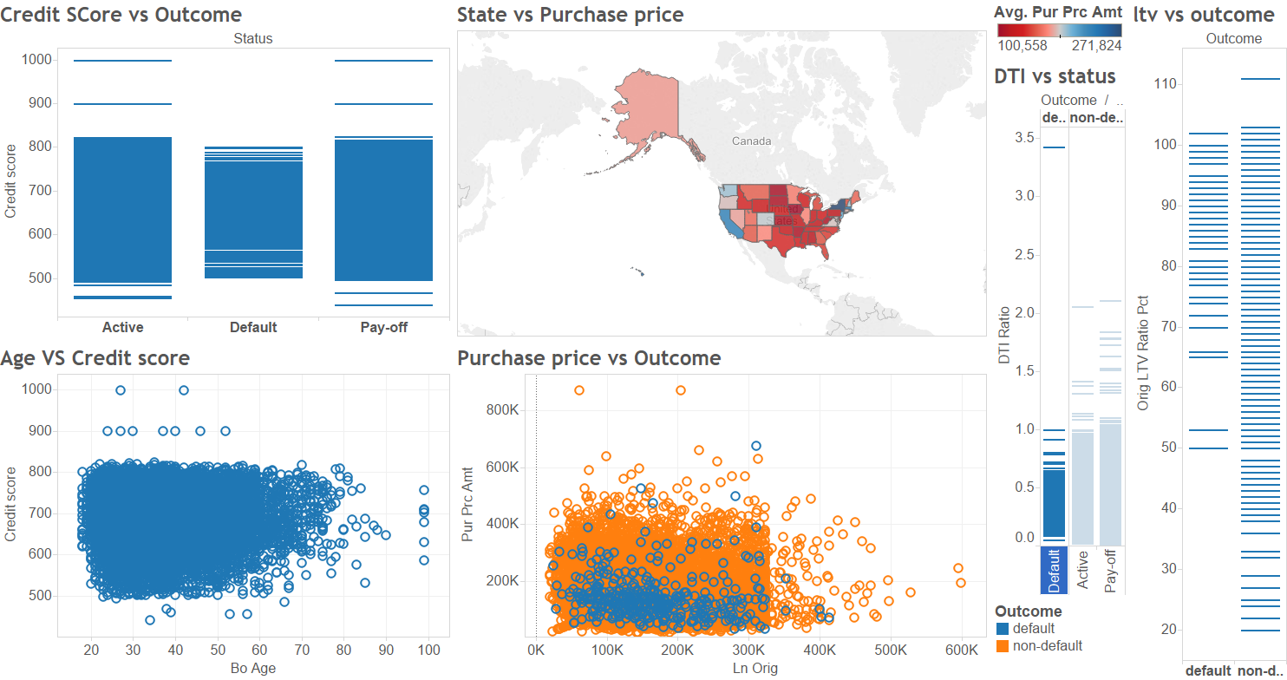
Case 2: Mortgage Defaults

Slide 10
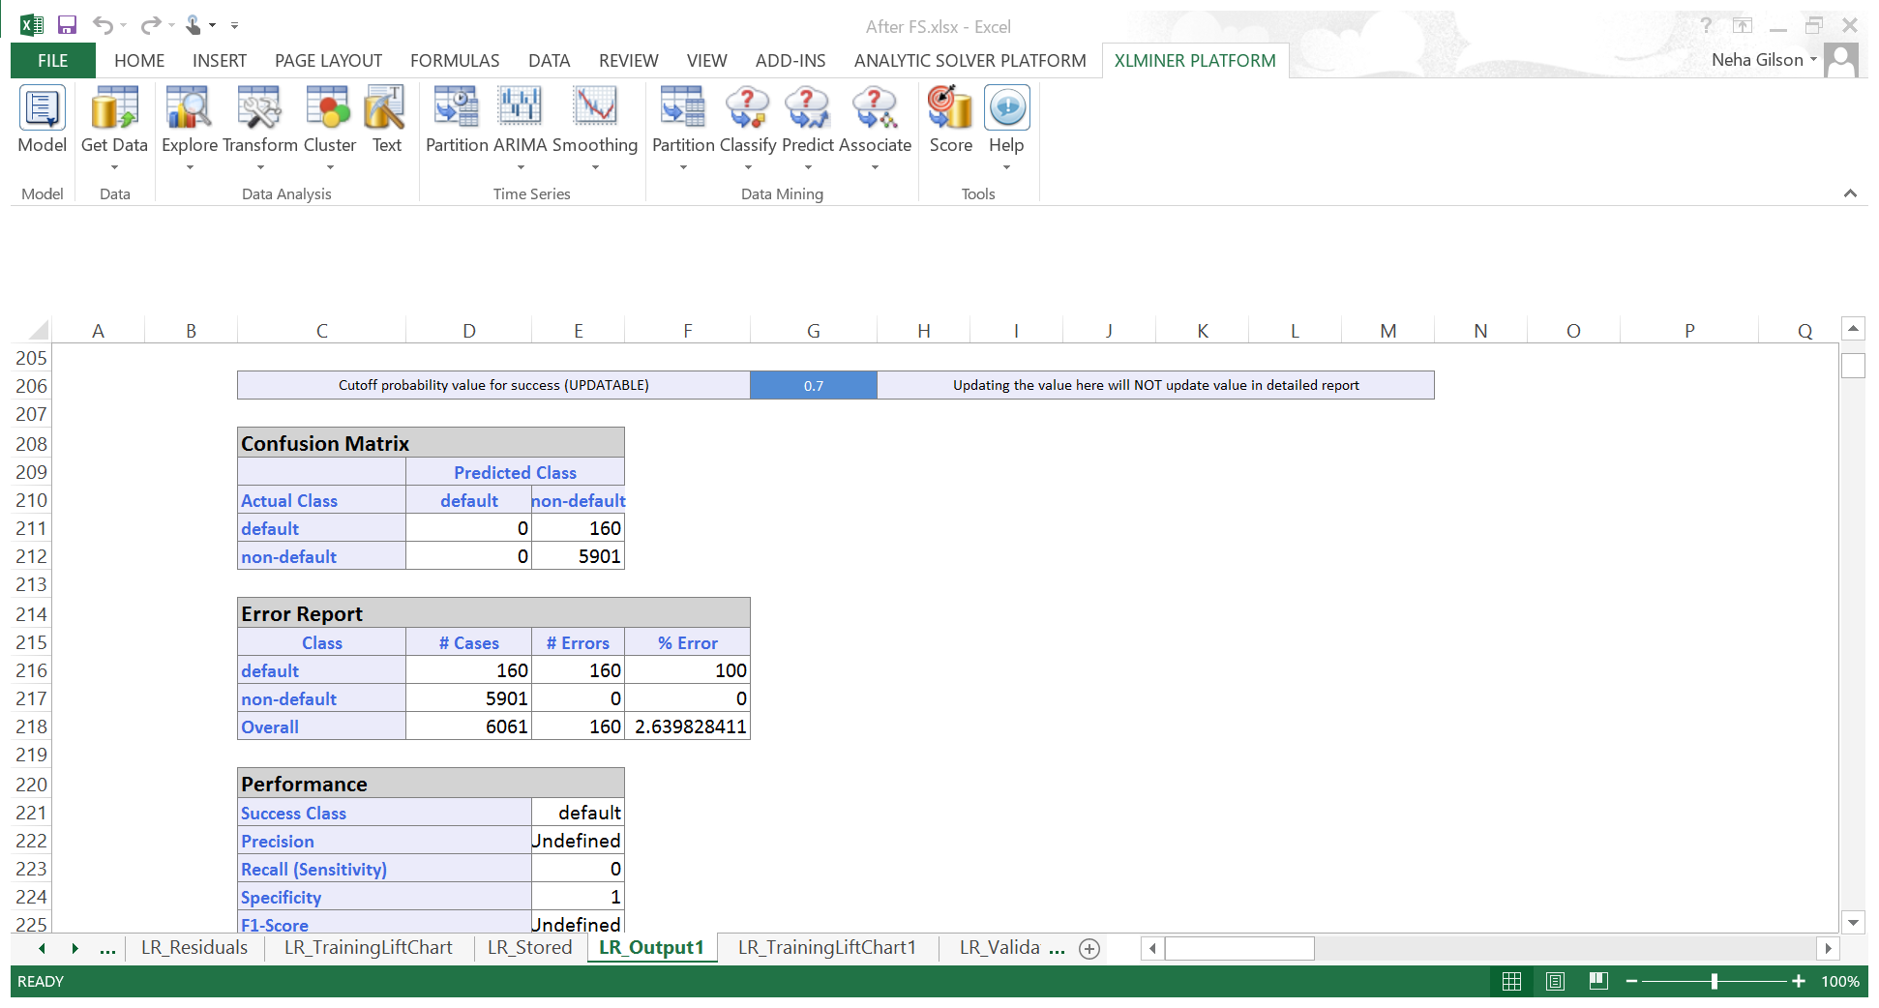
Logistic Regression

Slide 11
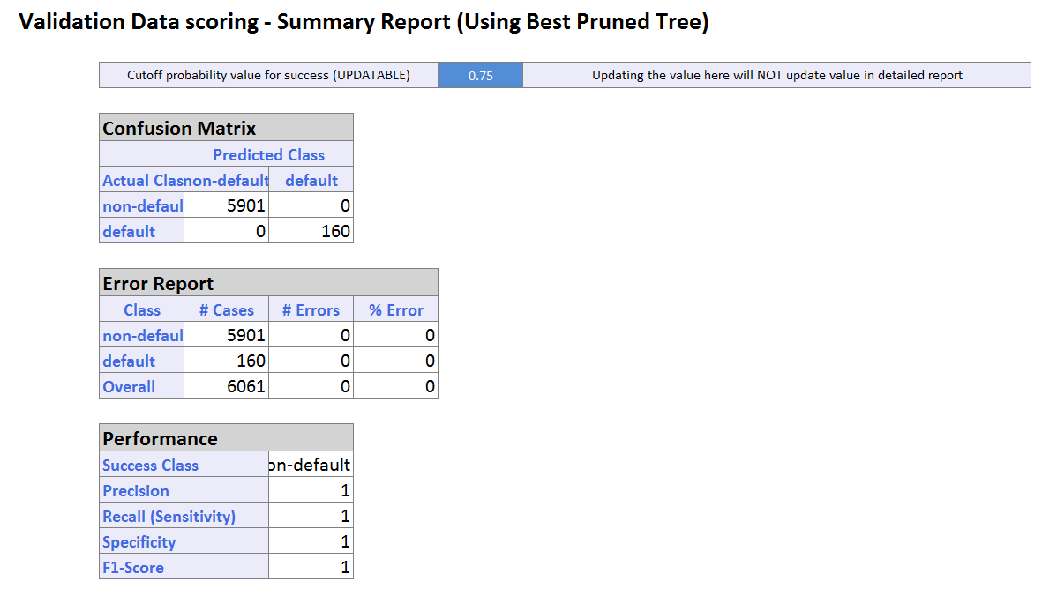
CART

Slide 12
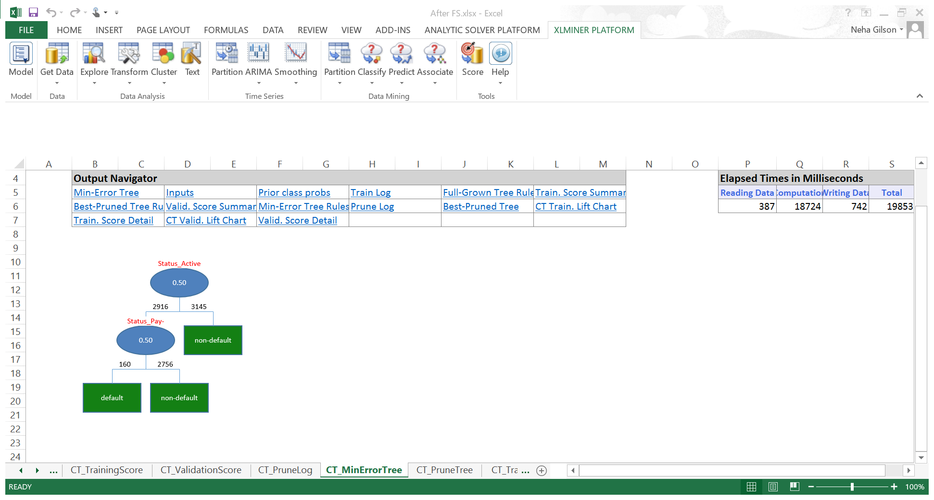

Slide 13
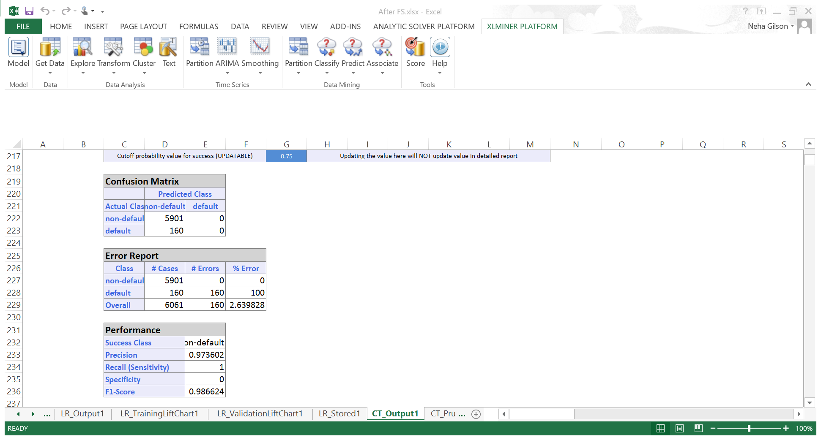
When ignoring status variable

Slide 14
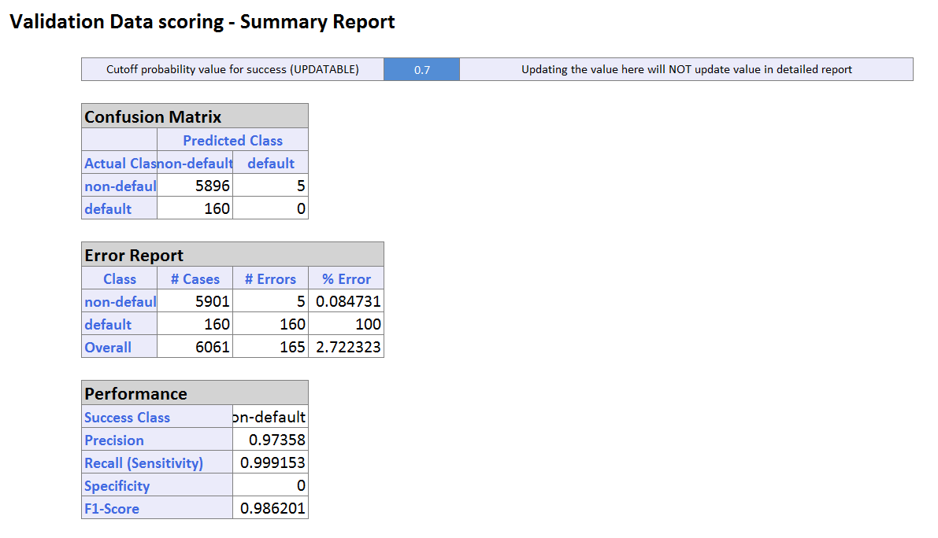
Random Forest

Slide 15
Conclusion
Lower the error in the confusion matrix, better the model.
Higher the area under the curve in ROC chart, the better the model.
After comparing the confusion matrix and AUC of ROC, we recommend Logistic Regression for classification future mortgages into default or non-default.

Slide 16
Case 3: Detecting Spam
In the spam dataset, there are 57 input variables and the output variable is spam which has binary value for indicating whether an email is spam or not. Among the 57 input variables, we made assumptions that some of them can be group together to compare how they impact the value of spam.
Goal: Building a classification model to classify an email into spam or normal email.

Slide 17
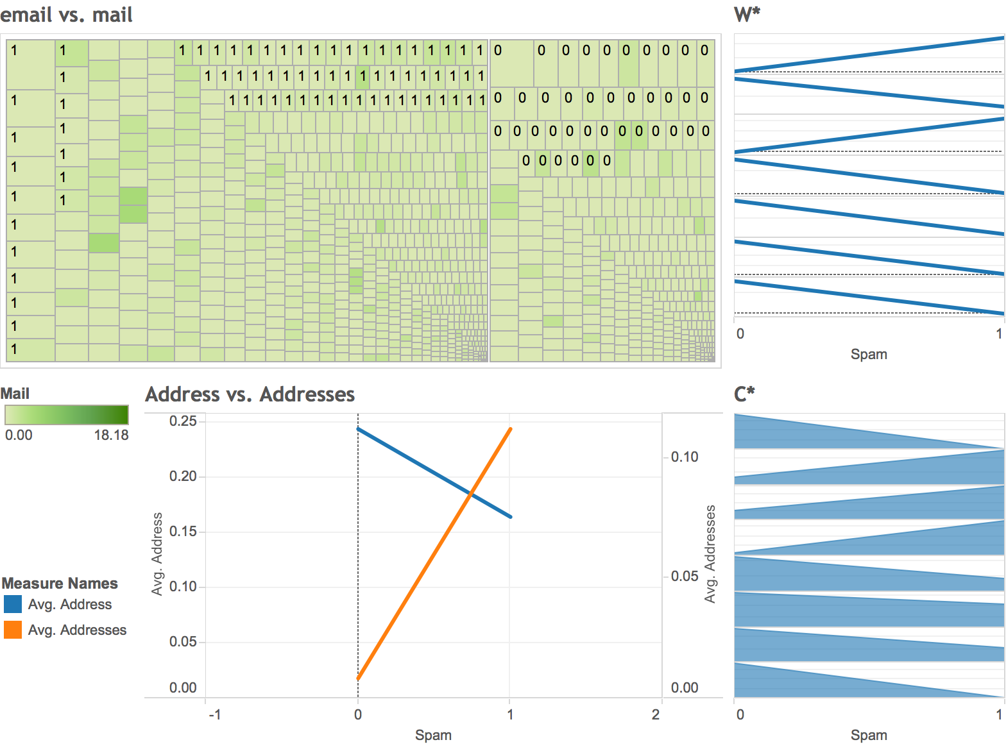
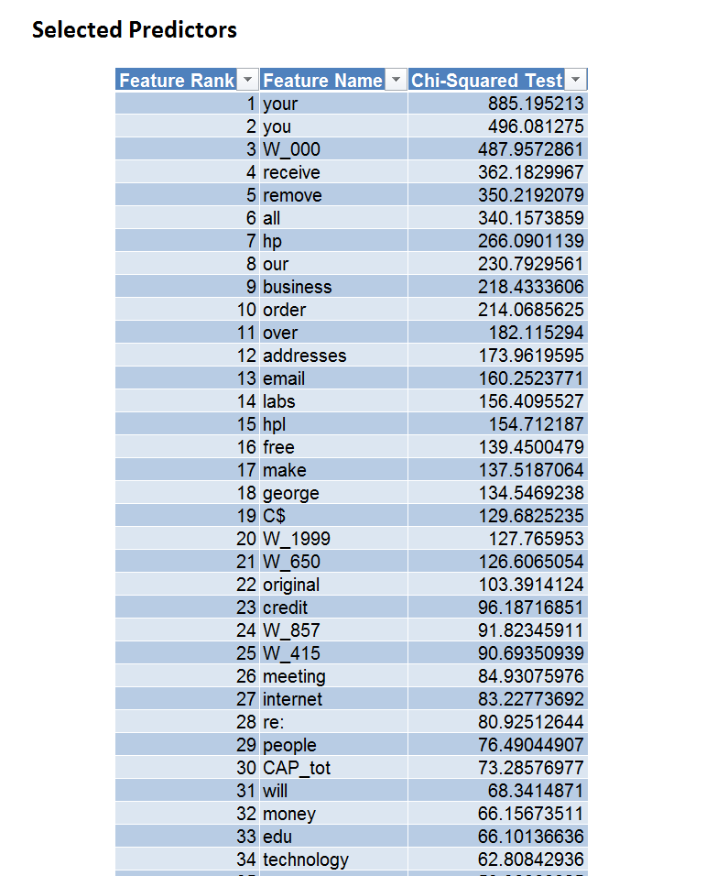
Data Exploration

Slide 18
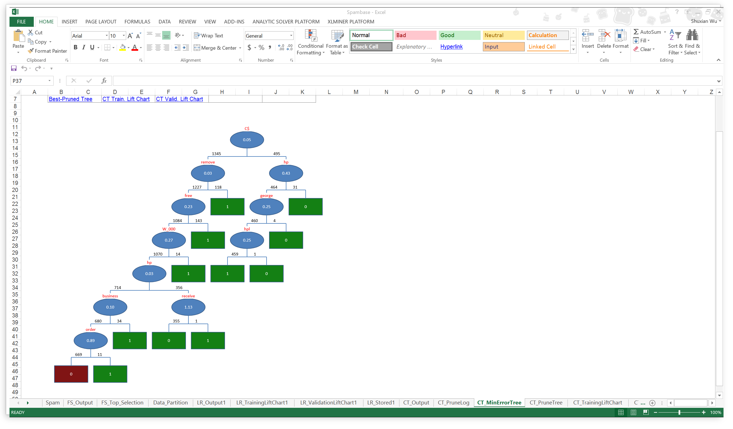
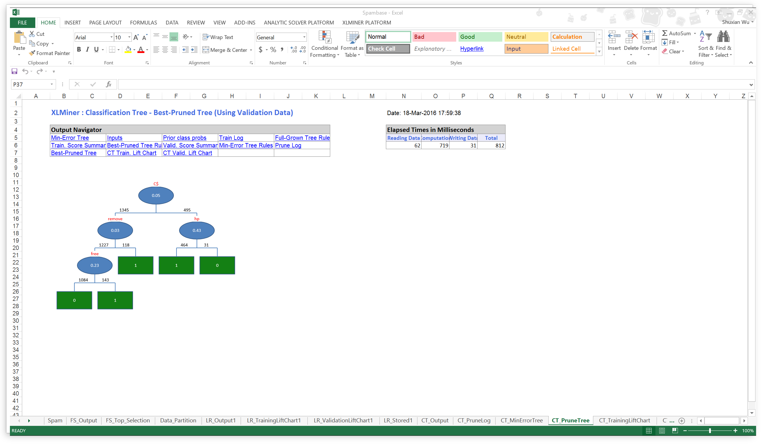
Case 3: Detecting Spam Cart

Slide 19
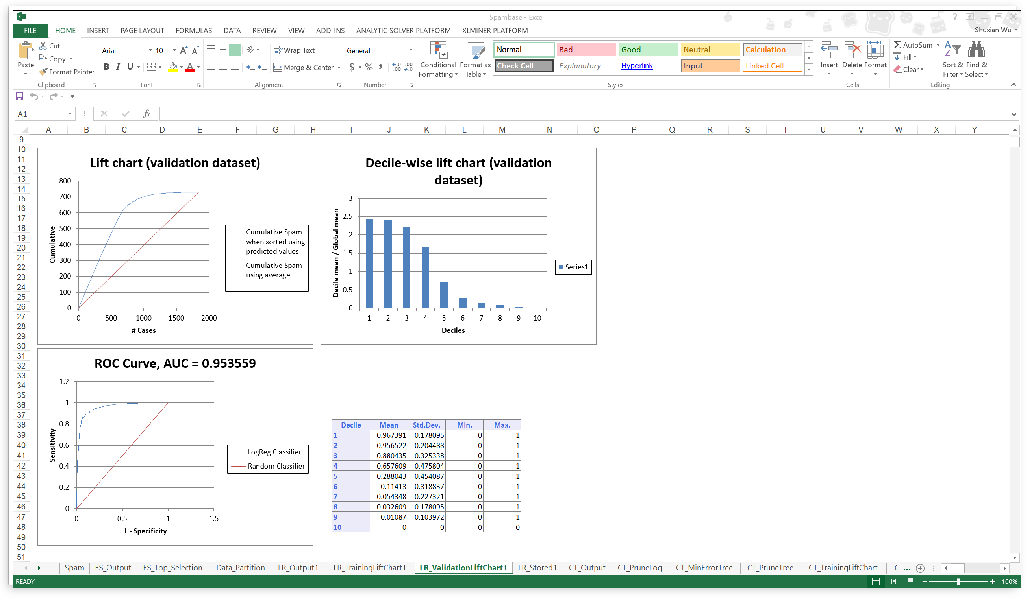
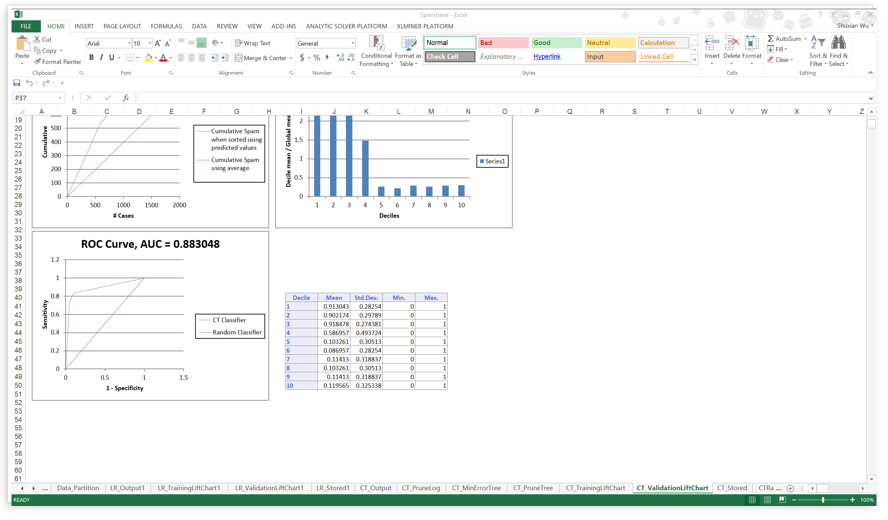
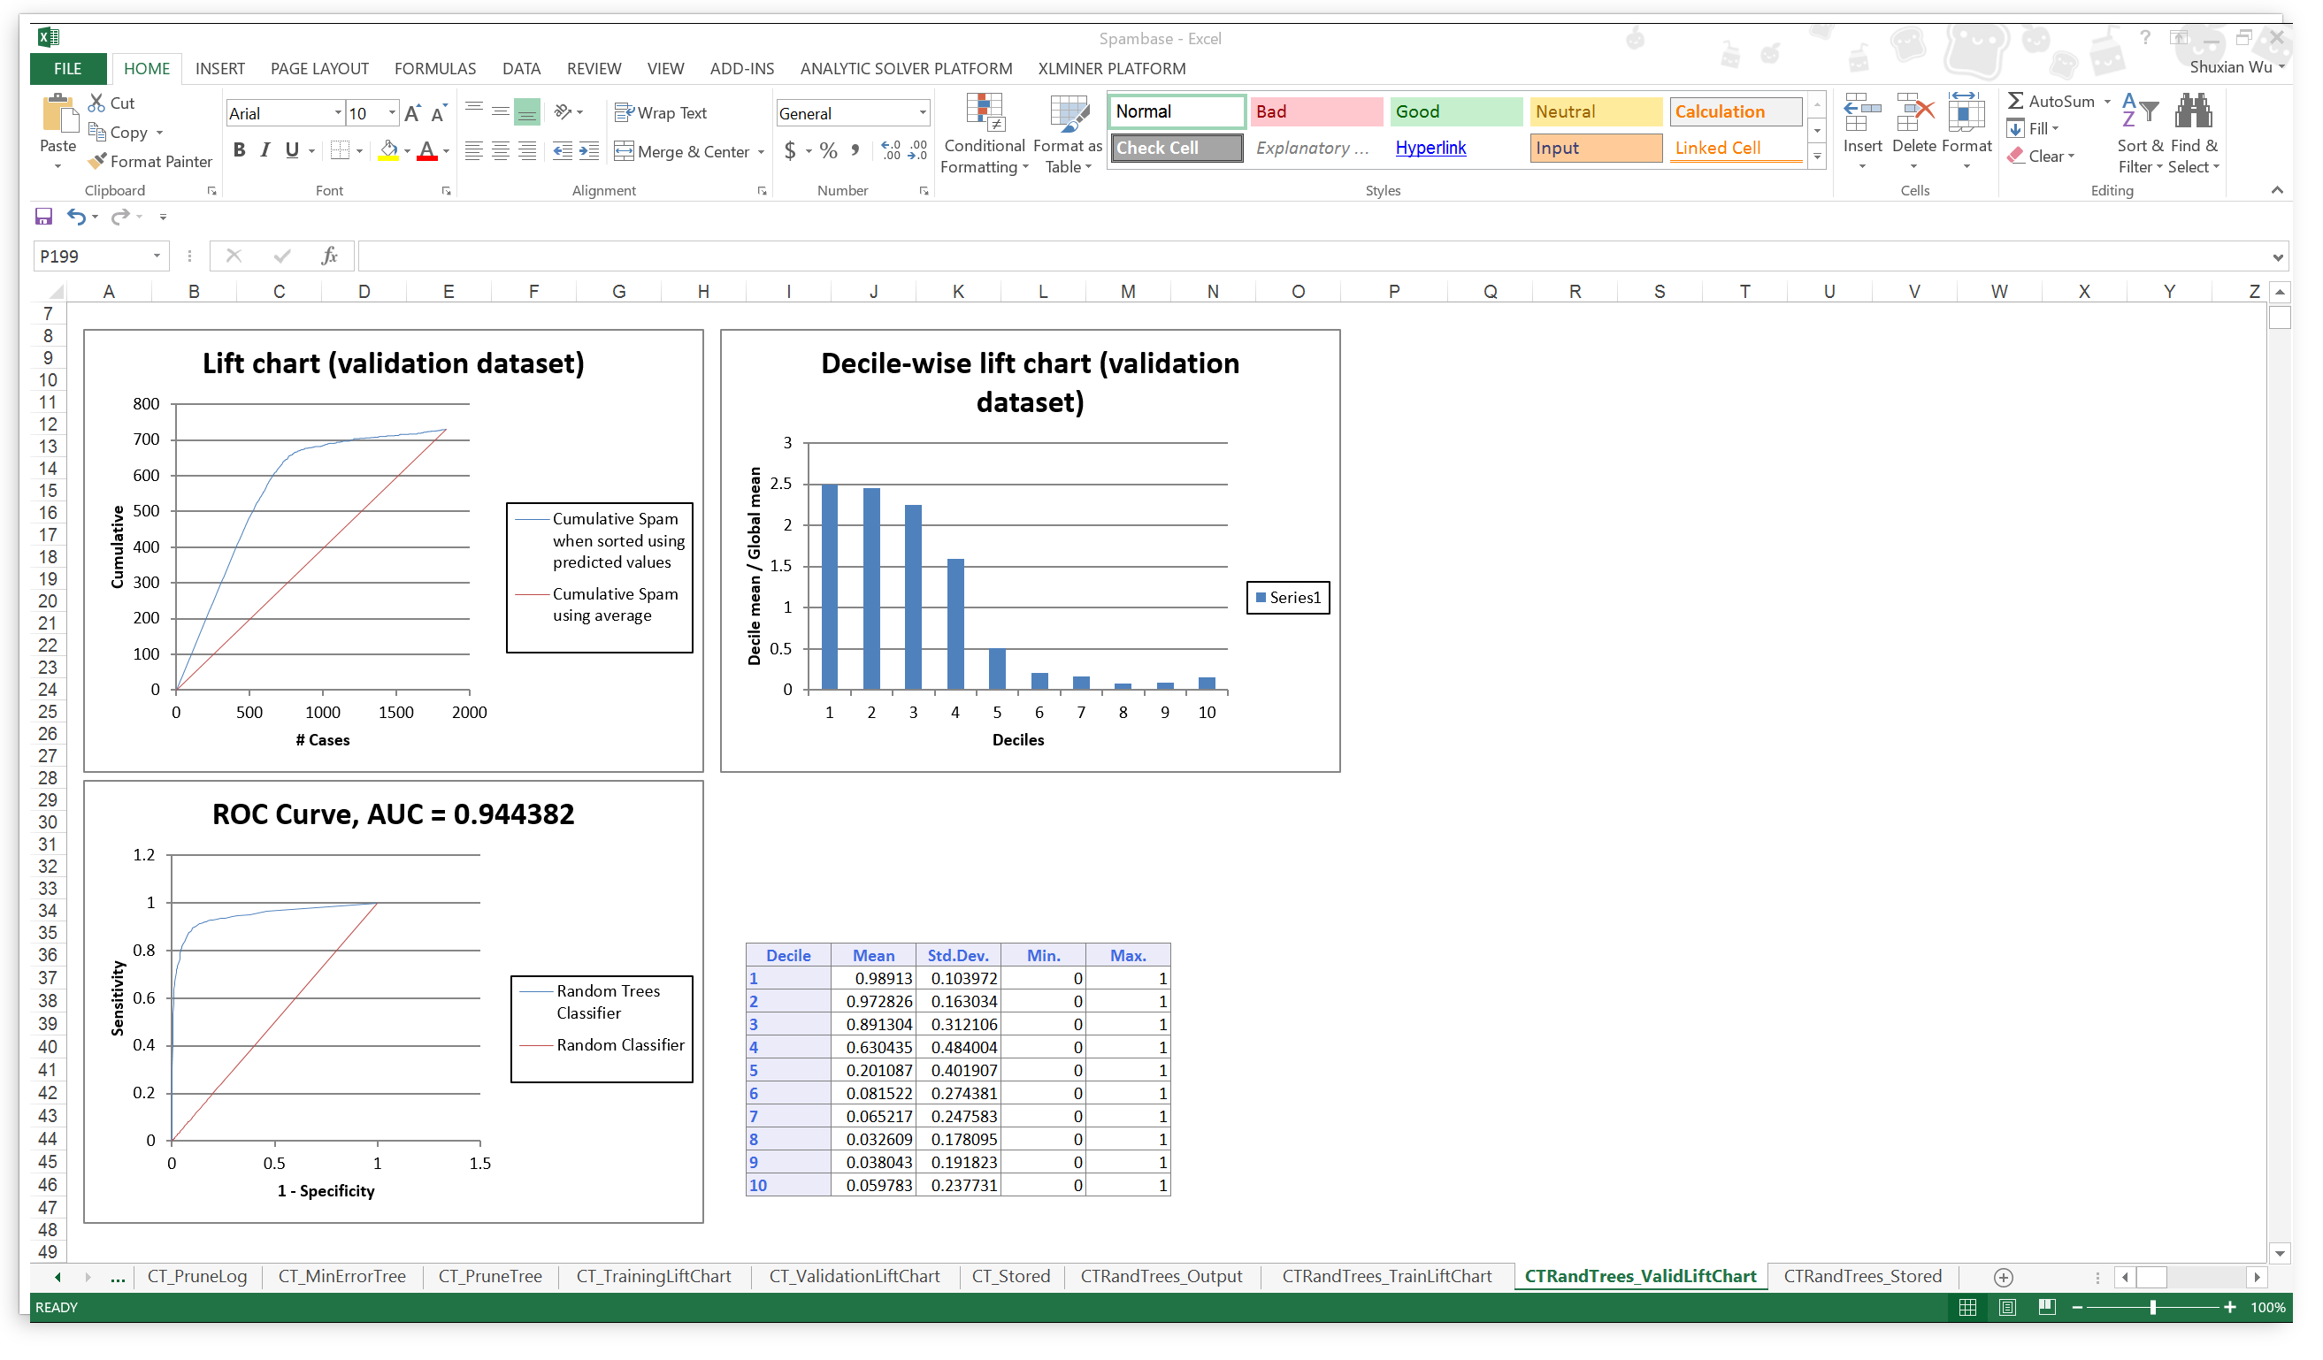
Case 3: Detecting Spam
Logistic Cart Random Forest

Slide 20
Case 3: Detecting Spam
 | Logistic | Cart | Random Forest
Overall % Error | 9.89 | 12.35 | 10
AUC | 0.9536 | 0.8830 | 0.9443
Cutoff Value | 0.45 | 0.75 | 0.5
Comparing the three value of each model listed in the table above, Logistic has the lowest Overall % Error and Highest AUC value, so that we think logistic regression is probably the best model to classify if an email is spam or not under certain selection of input variables.

Slide 21
Case 4: Blog feedback problem
Every dataset contains 281 columns. The rows represents different blog posts.
As mentioned in the question, we have to consider only the blog posts which were published 72 hours before the basetime.
Columns 263-269 are the binary indicator for the weekday of the basetime and columns 272-276 represent the binary indicator for the weekday of the date of publication.
So we make combinations of basetime and date of publication such that each combination has different of 3 days that is 72 hours. The combinations of columns are as follows:
Both date of publication and basetime columns given in the data are weekdays

Slide 22
Contd..
Date of Publication of Blog Post | BaseTime
Column 275 [Saturday] | Column 263 [Monday]
Column 276 [Sunday] | Column 264 [Tuesday]
Column 270 [Monday] | Column 265 [Wednesday]
Column 271 [Tuesday] | Column 266 [Thursday]
Column 272 [Wednesday] | Column 267 [Friday]
Column 273 [Thursday] | Column 268 [Saturday]
Column 274 [Friday] | Column 269 [Sunday]

Slide 23
We make a separate model for each combination of Date of Publication & BaseTime.
There are Test datasets for each day of February 2012 and March 2012.
Fit the model and predict the values for the corresponding Test dataset.
Training dataset will be trained for each of the above cominations.
For Each Combination we take only those blogs which have Date of publication- Basetime=72 hours
For example : Model trained for combination 270-265 will be applied to predict values on Test dataset with date 2012/03/28 which has a basetime of Wednesday.( All values of column 265 are 1) .

Slide 24
Building Models
Experiment 1: Regression
We built multiple linear regression model and tested it for various days using various input parameters . The combinations of input parameters are as follows:
Basic Features
Basic+Weekday
Basic+Parent
Basic+Textual
Bagging
The best one we found was Regression with Bagging

Slide 25
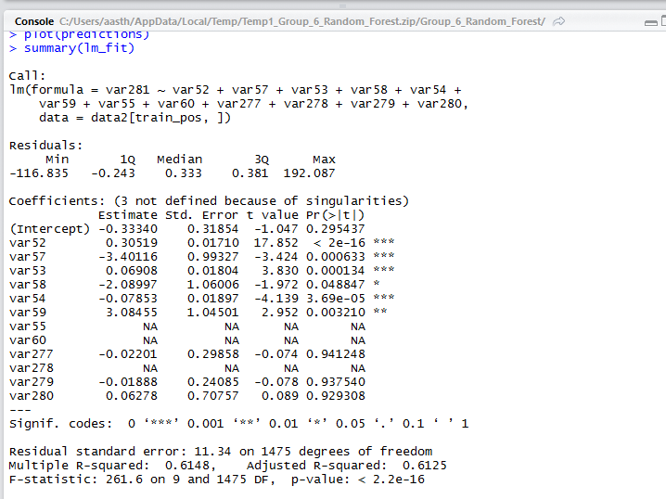
Summary(lm_fit)

Slide 26
Building Models(Contd)
Experiment:2: CART Regression
We build CART Regression model and tested on the same dataset.
RMSE Error came out to be 8.10
Experiment 3: Random Forest
RMSE Error came out to be 17.32

Slide 27
Evaluating Model’s Performance: RMSE Error Table
 | Bagging(Regression) | Cart Decision Tree | Random Forest
Saturday 2012/03/31 | 28.70281 | 22.179 | 22.179
Wednesday 2012/03/28 | 8.10 | 8.12 | 17.32
Wednesday 2012/02/29 | 13.711 | 13.73 | 15.62
Friday 2012/3/30 | 11.82 | 12.32 | 9.32
Regression used with Bagging gives the minimum RMSE Errors.
Also the R^2 and adjusted R^2 values for Regression Bagging are high which means the predicted values are close to the real ones.
T values for Bagging shows the used features as the most significant ones in this model

Slide 28
Recommendation:
After trying these 3 models on all the datasets for different days of the week, We found that the model with best performance was Regression with bagging.
Reason: Regression with bagging performs best because it takes 100 randomly selected subsets of the basic features and predicted values for all of these 100 subsets of features.
The bagging model takes the average of these 100 prediction values. Hence Bagging model accounts for the maximum variance of information included for prediction.
We found the RMSE Error values to be lowest for the regression model used with Bagging.
Hence we highly recommend this model.

